Slide 1

DEPARTMENT OF COMPUTER SCIENCE AND ENGINEERING
Project name: SMART PARKING
Team name: Proj_224789_Team_1
Team members:
SRIRAM S (113321104097)
SUBIKSHYA KUMAR (113321104099)
SURYOTHAYAN A (113321104100)
THIMMARAYAN M (113321104102)

Slide 2
INNOVATION:
One of the key innovations in smart parking is the use of sensors and IoT (Internet of Things) technology. These sensors can be embedded in parking spaces to detect the presence of vehicles. They transmit real-time data to a central system, which can be accessed by users through mobile apps or other platforms. This technology reduces the time and frustration of searching for a parking spot.
Advanced reservation systems allow users to book parking spots in advance. This is particularly useful for events or busy urban areas.
Smart parking systems can be integrated with GPS and navigation systems, guiding drivers to available parking spaces and reducing traffic congestion.
Improved security measures include surveillance cameras and emergency buttons for user safety. These innovations help deter criminal activity in parking areas.
Ensuring accessibility for differently-abled individuals is an essential innovation, with designated parking spots, ramps, and facilities.

Slide 3
OBJECTIVES:
Efficient Space Utilization: Smart parking systems aim to maximize the use of available parking spaces, reducing congestion and making it easier for drivers to find a parking spot.
Reduced Traffic Congestion: By helping drivers find parking spaces quickly, smart parking systems can reduce the time spent circling in search of a spot, which, in turn, helps decrease traffic congestion in urban areas.
Improved User Experience: Smart parking systems aim to enhance the experience of parking by providing real-time information about available spaces, enabling online reservations, and simplifying payment processes.
Increased Revenue for Operators: Efficient use of parking facilities and the ability to offer value-added services like reservations and premium parking options can increase revenue for parking facility operators.
Adaptive Pricing: Implementing demand-based pricing encourages users to park in less congested areas or during off-peak times, helping to balance demand.
Safety Features: Ensuring that parking facilities are well-lit, monitored, and equipped with emergency buttons contributes to the overall safety of users.

Slide 4
REQUIREMENTS:
Parking Sensors: To monitor parking space occupancy, you need various types of sensors, such as ultrasonic sensors, infrared sensors, or magnetic sensors, placed in each parking space. These sensors detect the presence or absence of vehicles.
User Interface: A user-friendly interface is necessary for both operators and end-users. Operators need an interface to manage the system, while end-users require apps or displays to find available parking spaces and make reservations.
Payment and Billing System: To facilitate payments and billing for parking services, you need an integrated payment gateway that supports various payment methods, including credit cards, mobile payments, and contactless options.
Security Measures: Ensure the system has robust security features to protect user data, financial transactions, and the physical security of the parking facilities.
Reservation and Booking System: If your system allows reservations, you need a reservation and booking module that enables users to reserve parking spots in advance.
Access Control: In some cases, an access control system is needed to manage entry and exit gates, barriers, or bollards, particularly in private or gated parking facilities.
Maintenance and Support: Establish a maintenance plan to keep sensors and equipment in working order. Provide customer support for user inquiries and issues.

Slide 5
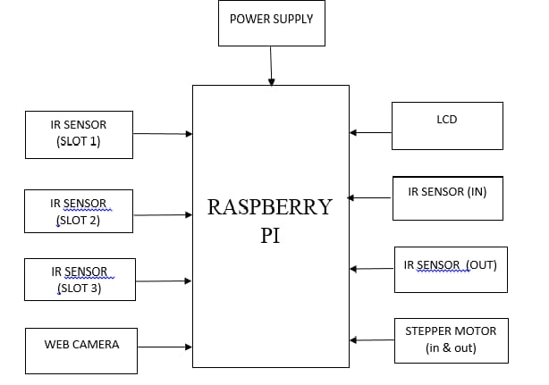
RASPBERRY Pi INTEGRATION:

Slide 6
CODE IMPLEMENTATION:
import random
# Simulate parking spaces
total_spaces = 20
available_spaces = random.randint(0, total_spaces)
# Function to check parking availability
def check_availability():
global available_spaces
if available_spaces > 0:
available_spaces -= 1
return True
else:
return False
# Function to free up a parking space
def free_up_space():
global available_spaces
available_spaces += 1
# Simulate user arrival and parking
def user_arrival():
if check_availability():
print("Parking space available. You may park.")
else:
print("Sorry, the parking lot is full. Please try again later.")
# Simulate user departure and freeing up a space
def user_departure():
free_up_space()
print("Thank you for using our parking. Have a safe journey!”)

Slide 7
# Simulate the smart parking system
if __name__ == "__main__":
while True:
print(f"Available parking spaces: {available_spaces}/{total_spaces}")
print("1. Arrive at the parking lot")
print("2. Depart from the parking lot")
print("3. Exit")
choice = input("Select an option: ")
if choice == "1":
user_arrival()
elif choice == "2":
user_departure()
elif choice == "3":
break
else:
print("Invalid option. Please select again.")

Slide 8
CONCLUSION:
Smart parking systems represent a forward-thinking approach to addressing the challenges of urban mobility and parking management. They offer a more efficient, user-friendly, and environmentally responsible solution to one of the common frustrations in urban living. As technology continues to advance, smart parking systems will likely become even more integrated with urban infrastructure and play a crucial role in shaping the smart cities of the future. smart parking systems represent a significant innovation in urban transportation and infrastructure management.

Slide 9
THANK YOU

